Slide 1
Introduction to Data Visualisation & Dashboards
A short course on Tableau

Slide 2
Table of Contents
1
Welcome: Learning Objectives & Introductions
2
25 mins + 5 mins break
Part 1 – Understanding Data
3
Part 2 – An Introduction to Data Visualisation
4
25 mins + 5 mins break
Part 3 – Tableau as a Tool for Business Analytics & Visualisation
5
45 mins + 15 mins break
Part 4 – Basic Data Visualisation
6
35 mins + 10 mins break
Part 5 – Advanced Data Visualisation
7
Part 6 – Dashboard & Storyboards
15 mins
You will need Tableau Desktop 2021 installed for this seminar

Slide 3
Welcome: Learning Objectives & Introductions

Slide 4

About the Instructor
Munish Kumar, PhD, B Eng
Staff Geoscientist (Petrophysicist) – ERCE
12 years in oil & gas; worked at ExxonMobil and Total S.A. in strategy, portfolio, planning, upstream exploration, field development and production optimization
In 2020, joined expert consultancy firm ERCE which provides energy consulting/auditing services (including greenhouse gas evaluation) to oil & gas, law firms, banks, institutional investors etc.
Adjunct Faculty – SUSS
Data Visualisation for Business
Python for Business
Applied Project for Business Analytics
Name
Profession/ What you do/ What you like
Do you currently use visualisation?
What would be one thing you want to take away from this class?
Tools of the trade: Python, Tableau, Power BI, Excel

Slide 5
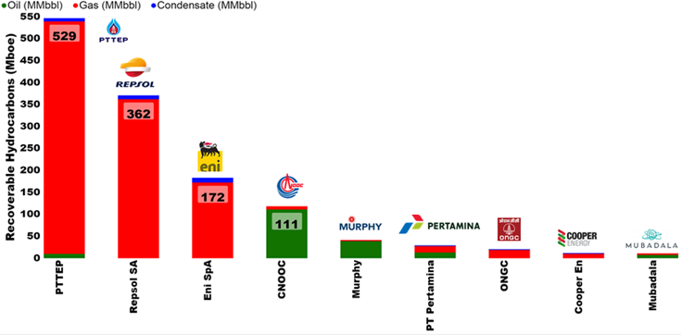
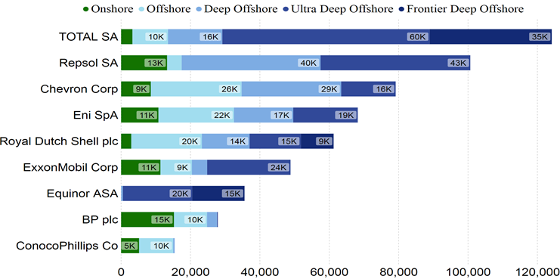
Learning Objectives
Understand concepts of Data and Data Visualization
Stages of Data Visualization Process
Data Visualization Components
Design Principles of a Business Performance Dashboard
Appropriateness of Data Visualization techniques based on available data
Appropriates of Business Performance Measure against Business Strategy of Organization
Some Textbooks:
Yau, N,.(2013). Data Points: Visualization that Means Something
Murray, D. G. (2013). Tableau Your Data

Slide 6
Part 1 – Understanding Data

Slide 7
Understanding Data
The four measurement levels of data quality attribute
Nominal measurements measure items based on their labels or categories or other qualitative classification the items belong to with no implied order
Ordinal measurements arise from the operation of rank ordering
Interval measurements allow us to measure the degree of difference between items, but not the ratio between them
Ratio measurements estimate the ratio between a magnitude of a continuous quantity and a unit magnitude of the same kind

Slide 8




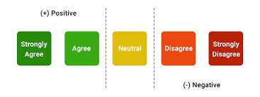



Understanding Types of Data
Types of Data
Tableau refers to interval or ratio data as “measures”.
All others are known as “dimensions”
Qualitative
Quantitative
Arithmetic
Measuring the data
Nominal
Ordinal
Interval
Ratio
○K
Unordered
Ordered Words
Discrete
Continuous
No True Zero

Slide 9
How Tableau Views Types of Data
Dimensions contain qualitative values (such as names, dates, or geographical data).
Dimensions can categorize, segment, and reveal the details in your data.
Dimensions affect the level of detail in the view.
Measures contain numeric, quantitative values that you can measure.
Measures can be aggregated.
When you drag a measure into the view, Tableau applies an aggregation to that measure (by default)
Green measures and dimensions are continuous. Continuous field values are treated as an infinite range. Generally, continuous fields add axes to the view.
Blue measures and dimensions are discrete. Discrete values are treated as finite. Generally, discrete fields add headers to the view.

Slide 10
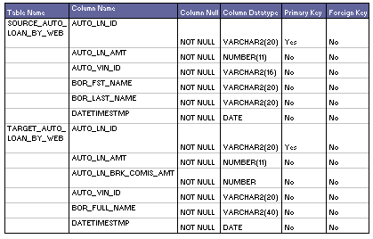
Understanding Data
Metadata
Metadata is structured information that explain, describe or locate the original (i.e. also known as primary data), otherwise make the using of original data more efficient
Source: http://learndatamodeling.com/wp-content/uploads/2015/10/tmeta.gif

Slide 11
Part 2 – An Introduction to Data Visualisation

Slide 12
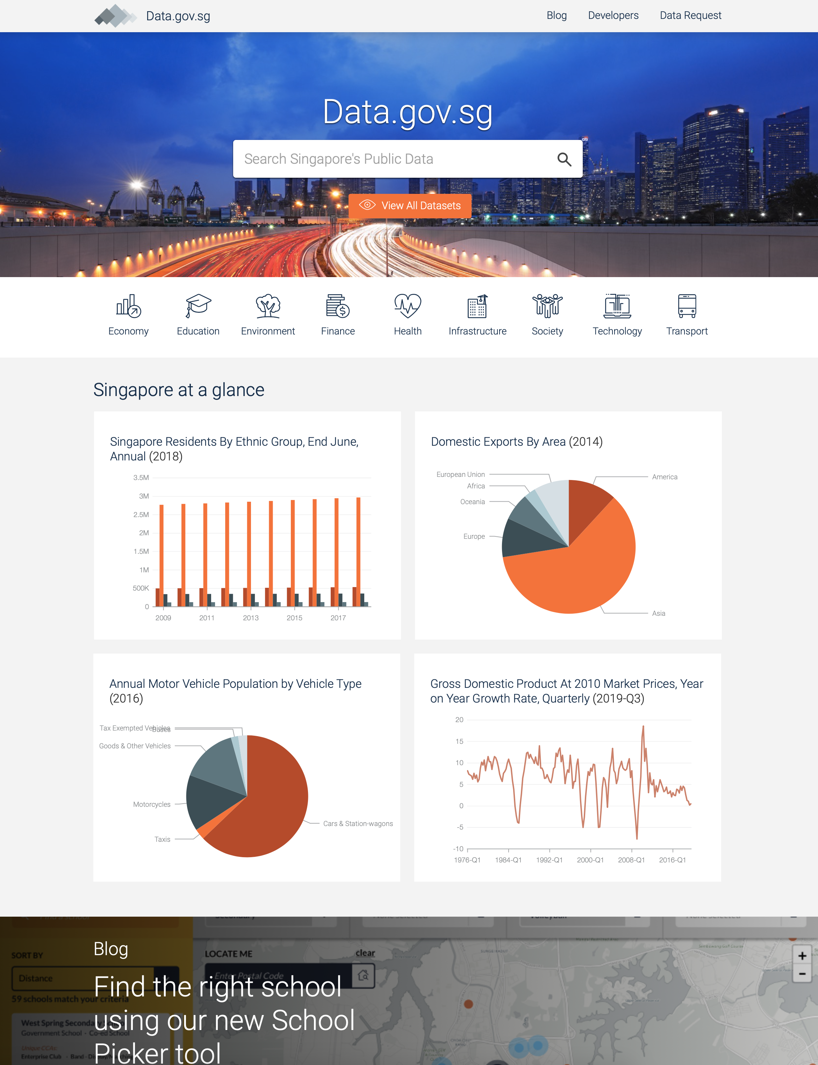
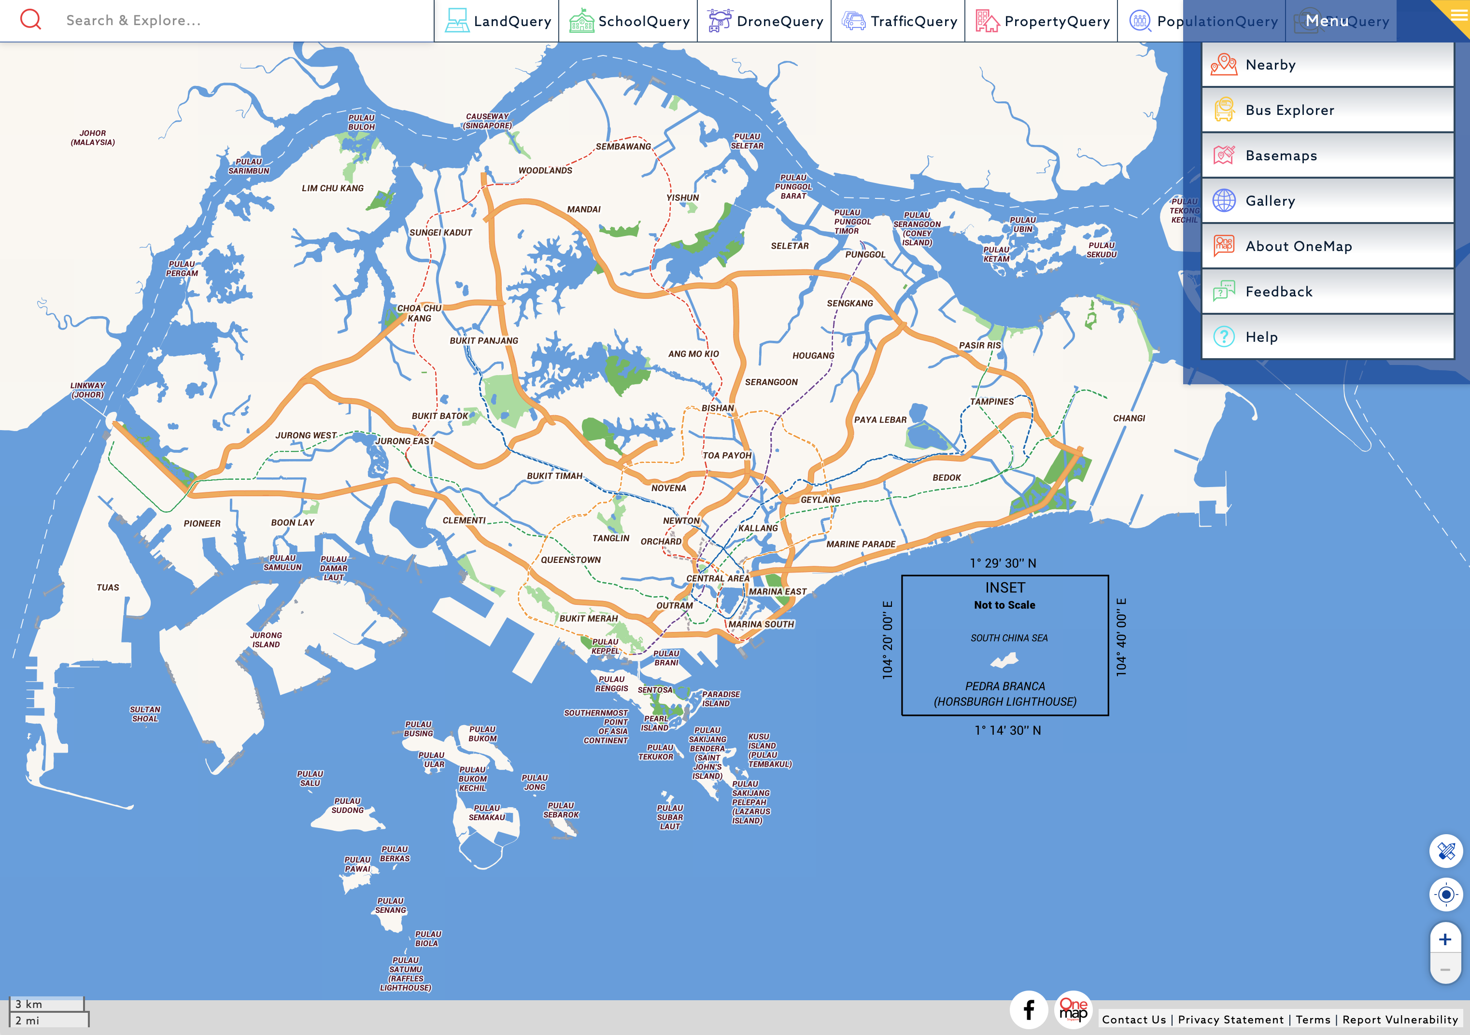
Data Visualisation
Overwhelming amount of data available today
A coloured map is essentially millions of data points/ measurements.
Overwhelming in an excel sheet, but easy to see if visualized properly

Slide 13
Data Visualisation
The four stages of the data visualisation process
Data Collection and Storage: the collection and storage of data
Data Pre-processing: the pre-processing of data to transform it into something one can understand
Graphics Engine: the display hardware and the graphics algorithms to produce data visualisation on screen
Human Visual and Cognitive Processing: human perceptual and cognitive systems that are involved in interpreting the visualised data
Source: Information Visualization: Perception for Design, C. Ware, 2013

Slide 14
Data Visualisation
Benefits
Provides us the ability to comprehend huge amounts of data
Allows the perception of emergent properties that are not anticipated (e.g. red for danger)
Often enable problems with data to become immediately apparent (missing data or blank (pixels))
Facilitates the understanding of both large-scale and small-scale features of the data
Facilitates hypothesis formation

Slide 15

5 mins

Slide 16
Part 3 – Tableau as a Tool for Business Analytics & Visualisation

Slide 17
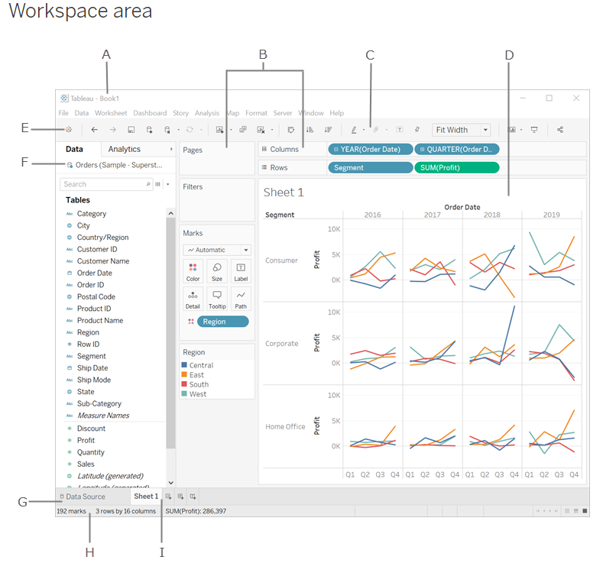
Tableau Interface
A. Workbook - contains sheets ( either a worksheet, dashboard, or story).
B. Cards and shelves - Drag fields to the cards and shelves in the workspace to add data to your view.
C. Toolbar - To access commands, analysis and navigation tools.
D. View - Workspace (Canvas) to create visualization ("viz").
E. Click this icon to go to the Start page to connect to data.
F. Side Bar- Contains the Data pane and the Analytics pane.
G. Data Source page - view and manipulate your data.
H. Status bar - Displays information about the current view.
I. Sheet tabs - Tabs represent each sheet (worksheets, dashboards, and stories) in your workbook.
Source: https://help.tableau.com/current/pro/desktop/en-us/environment_workspace.htm

Slide 18
Tableau File Extension
File Type | File Extension | Purpose
Tableau Workbook | .twb | It contains information on each sheet and dashboard that is present in a workbook. It has the details of the fields which are used in each view and the formula applied to the aggregation of the measures. It also has the formatting and styles applied. It also contains the data source connection information and any metadata information created for that connection.
Tableau Packaged Workbook | .twbx | This file format contains the details of workbook as well as the local data that is used in the analysis. Its purpose is to be share with other Tableau desktop or Tableau reader users assuming it does not need data from the server.
Tableau Data source | .tds | The details of the connection used to create the tableau report are stored in this file. In the connection details it stores the source type(excel/relational/sap etc.) as well as the data types of the columns.
Tableau Packaged Data source | .tdsx | This file is similar to the .tds file with the addition of data along with the connection details.
Tableau Data Extract | .tde | This file contains the data used in a .twb file in a highly compressed columnar data format. This helps in storage optimization. It also saves the aggregated calculations that are applied in the analysis. This file should be refreshed to get the updated data form the source.

Slide 19
Tableau Speak - Join, Union, Pivot, Relationships & Functions
Union vs Join
Union
Join
Month | Price | Quantity
Jan | 5 | 10
Month | Price | Quantity
Jan | 5 | 10
Month | Price | Quantity
Jan | 10 | 20
Month | Location
Jan | Bedok
Month | Price | Quantity
Jan | 5 | 10
Jan | 10 | 20
Month | Price | Quantity | Location
Jan | 5 | 10 | Bedok
Adding rows to existing data
Adding Columns to existing data

Slide 20
Tableau Speak – Join Types
Primary Table
Secondary Table
ID | Qty
A | 10
B | 20
C | 30
ID | Reg
A | East
C | West
D | North
Left
Right
Outer
Inner
ID | Qty | Reg
A | 10 | East
B | 20 | null
C | 30 | West
ID | Reg | Qty
A | East | 10
C | West | 30
D | North | null
ID | Qty | Reg
A | 10 | East
B | 20 | null
C | 30 | West
D | null | North
ID | Qty | Reg
A | 10 | East
C | 30 | West
Primary = “Master”
Secondary = “Slave”
Primary = “Slave”
Secondary = “Master”
Equivalent to
Logical “OR”
Equivalent to
Logical “AND”

Slide 21
Tableau Speak – Pivot Data & Data Source Grouping
Year | Age Group | Population
1959 | 0-4 | 100
1960 | 0-4 | 400
1961 | 0-4 | 700
1959 | 5-9 | 200
1960 | 5-9 | 0
1961 | 5-9 | 100
1959 | 10-14 | 300
1960 | 10-14 | 500
1961 | 10-14 | 200
Year | 0-4 | 5-9 | 10-14
1959 | 100 | 200 | 300
1960 | 400 | 0 | 500
1961 | 700 | 100 | 200
Pivoting reduces the number of columns, and increases the number of rows
Sometimes, by grouping data, the data structure and usability improves significantly.
Caveats:
Same Datasource
Same Connection
Excel, Textfile, Google Sheets, .pdf

Slide 22
Tableau Speak – Relationships & Data Blending
Primary Table
Secondary Table
ID | Qty
A | 10
B | 20
ID | Reg
A | East
B | West
Single Data Source
JOIN
ID | Qty
A | 10
B | 20
Data Source 1
RELATIONSHIP
Only Dimensions, not Measures
ID | Reg
A | East
B | West
Data Source 2

Slide 23
Tableau Speak – Building Blocks & Syntax for Data Source Manipulation with Calculated Fields
Roll | Student | Grade
1 | Ali | 80
2 | Benny | 40
3 | Carrie | 60
4 | Daffy | 50
Calculated
PAS
FAIL
PASS
FAIL
IF [GRADE] > 50 THEN “PASS“
ELSE “FAIL“
END
Functions
Fields
Operators
Literal Expressions
Number ABS(-3) = 3
[GRADE]
>
“PASS”
Strings Len(“Ali”) = 3
Type Conversion INT(50.1) = 50
Logical IF [Ali] THEN “Pass”
Source: https://help.tableau.com/current/pro/desktop/en-us/functions.htm

Slide 24
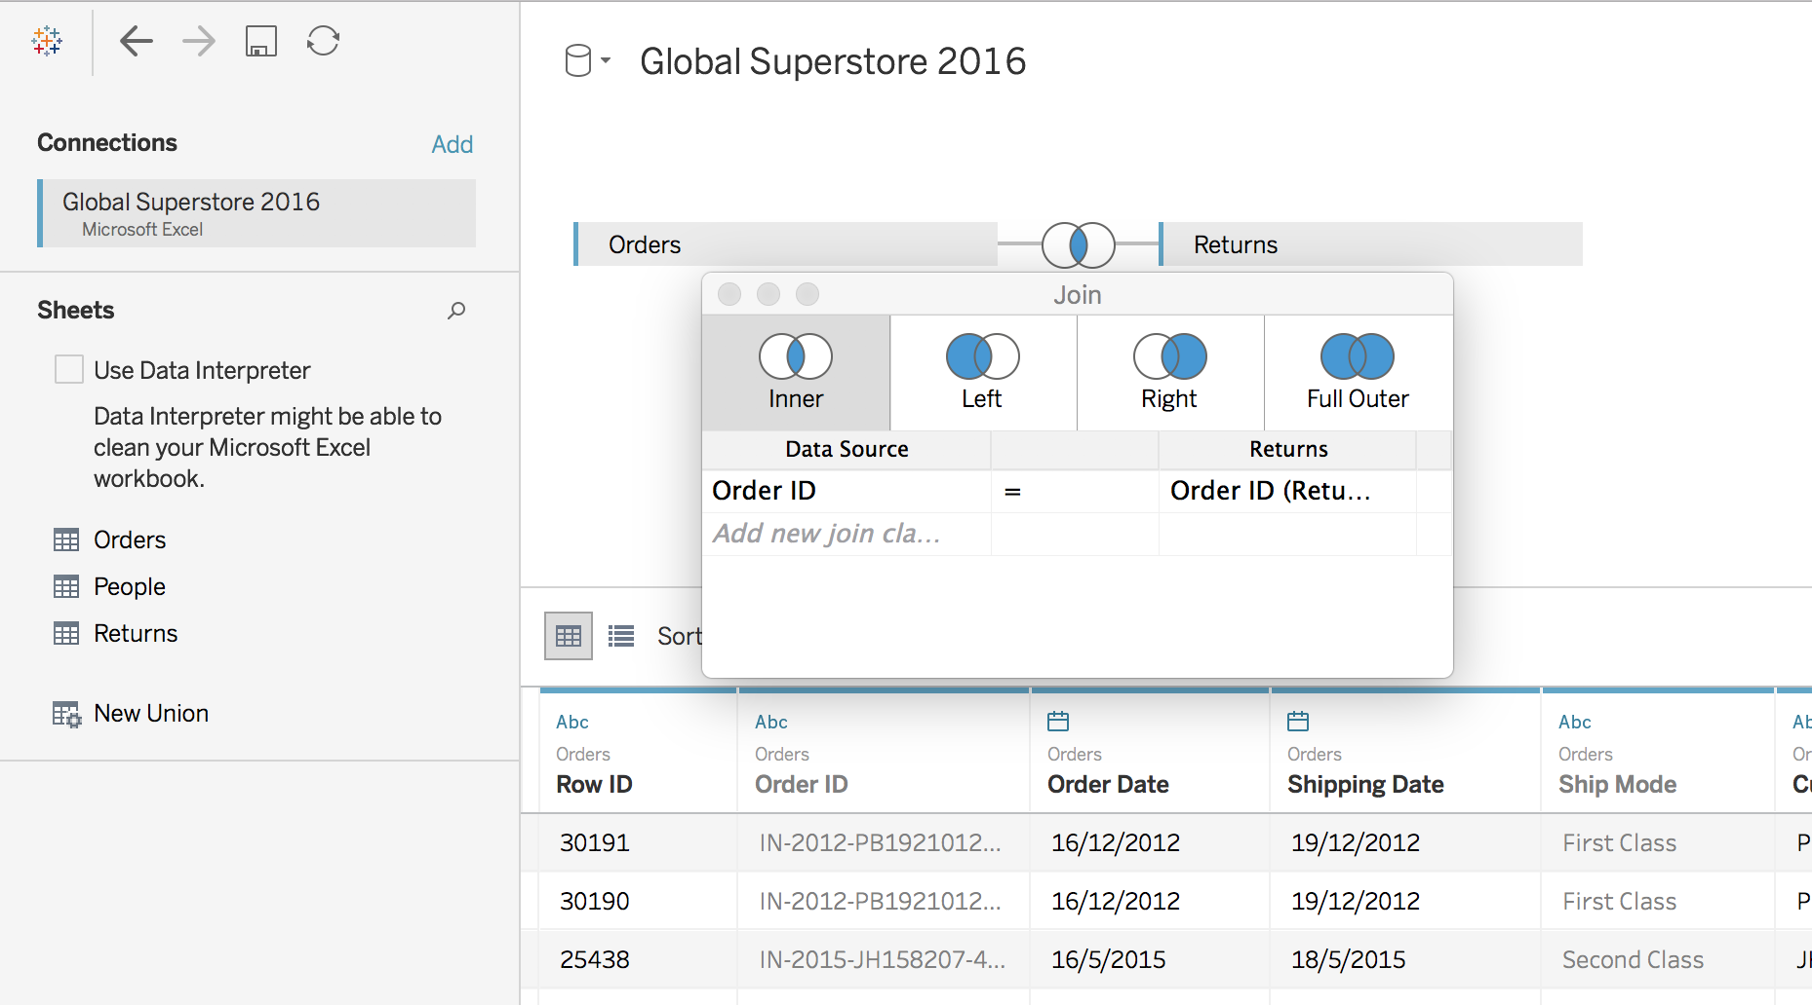
Tableau Speak – Table Join

Slide 25
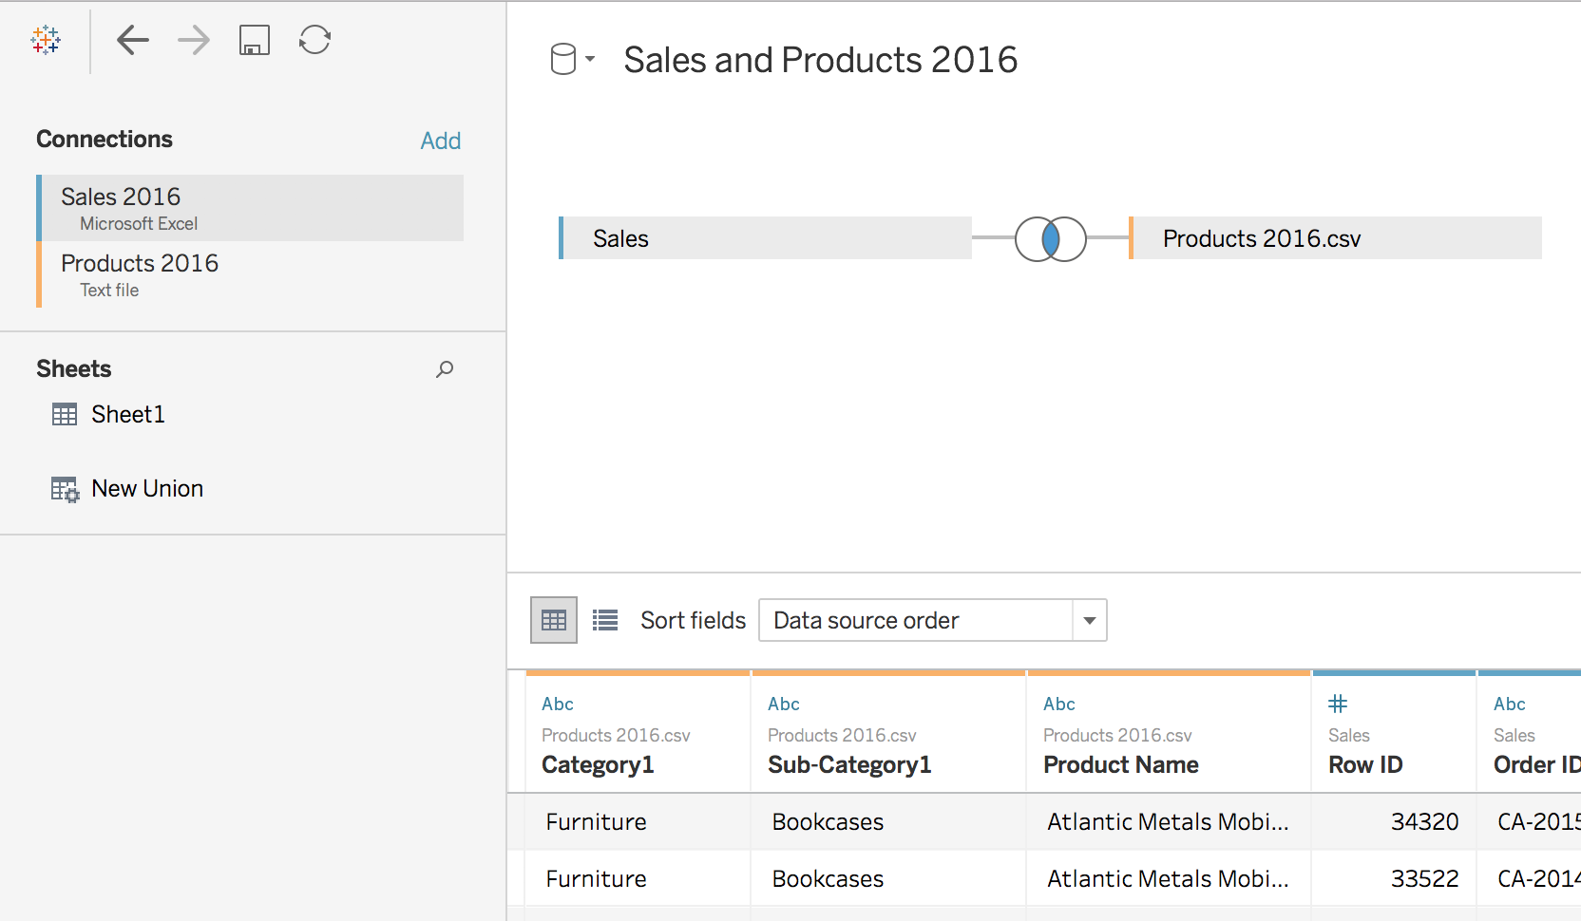
Tableau Speak – Cross-database Join

Slide 26
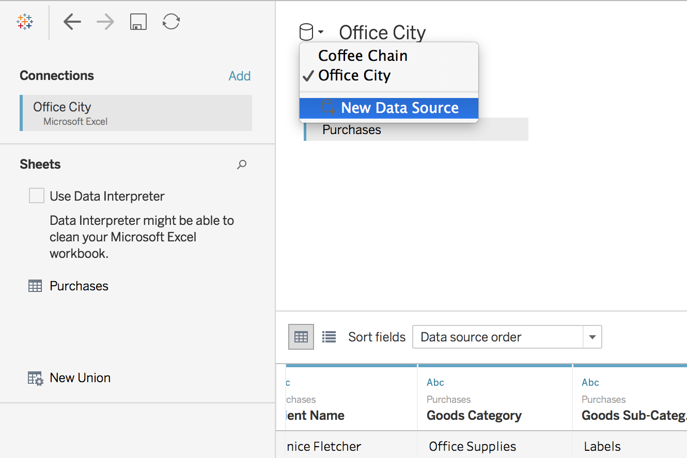
Tableau Speak – Data Blending

Slide 27
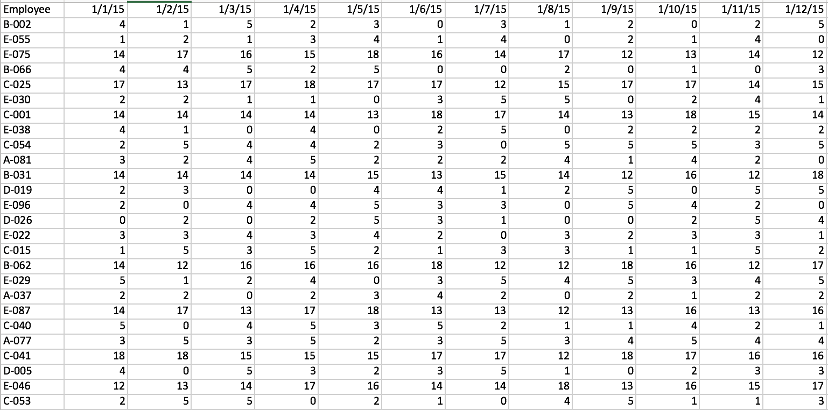
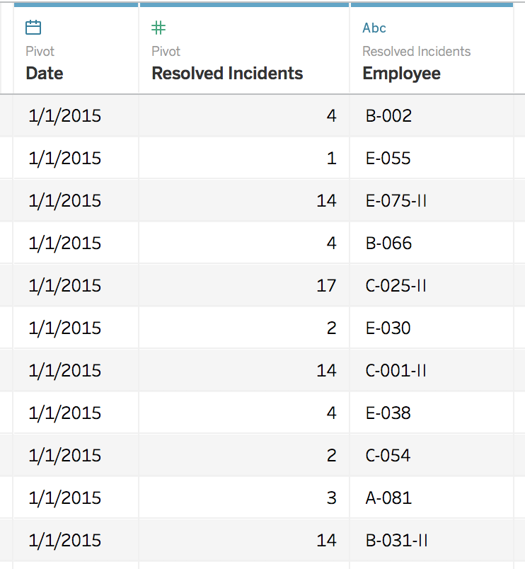
Tableau Speak – Pivot Data from Columns to Rows (or v.v.)
Pivot from wide to long format
Pivot from long to wide format

Slide 28
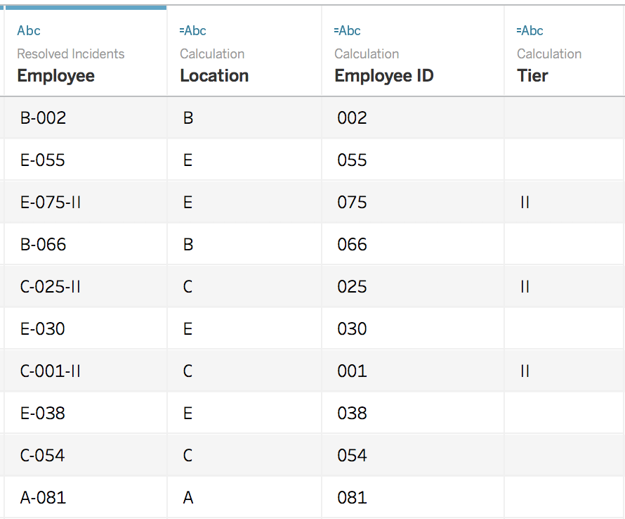
Tableau Speak – Split
Split “Employee” column:

Slide 29
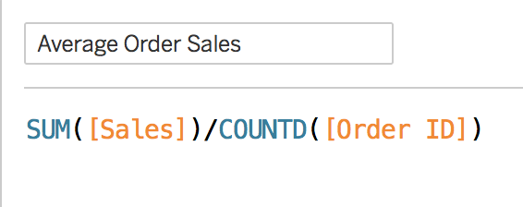
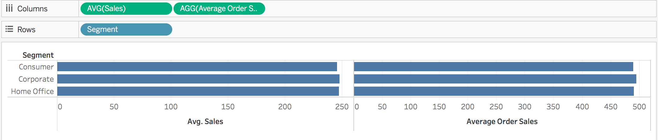
Tableau Speak – Calculation: Aggregate VS Record-Level

Slide 30
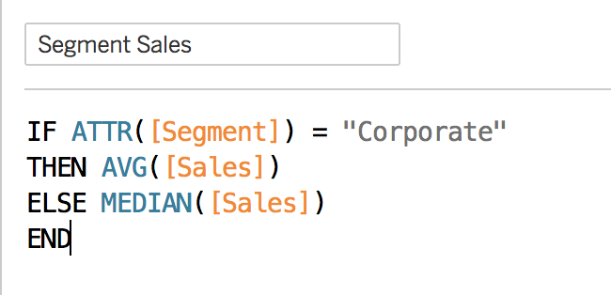
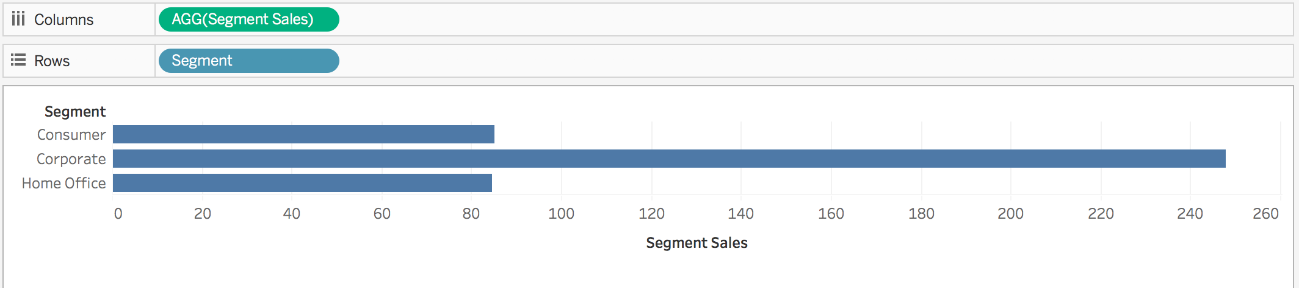
Tableau Speak –Aggregate Functions
Aggregation of a measure
Aggregation of a dimension

Slide 31










Ensure that you have the following datasets downloaded onto your computer:
global_superstore_2016.xlsx
Sales 2016.xlsx
Products 2016.csv
Coffee Chain.xlsx
Office City.xlsx

Slide 32
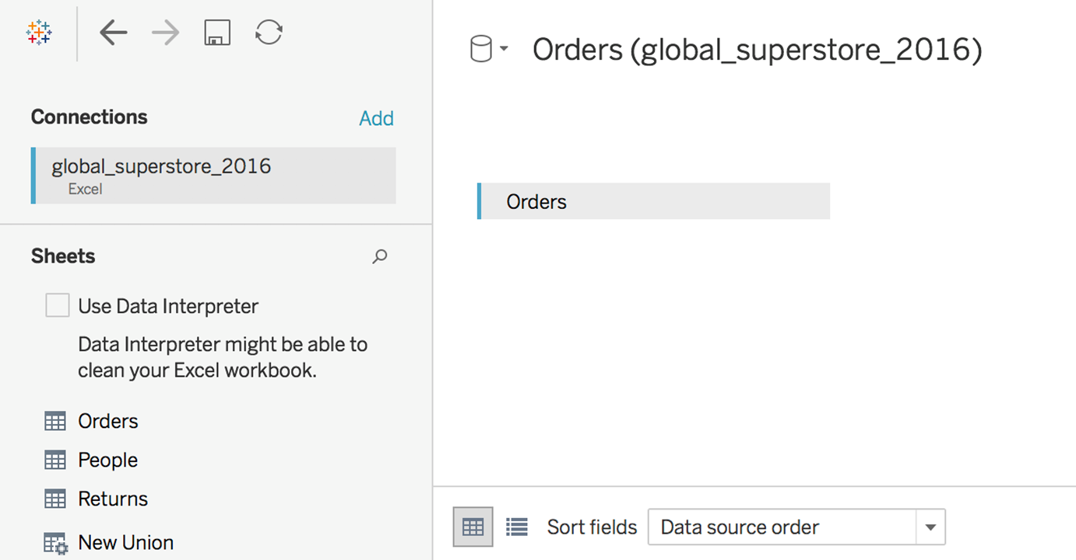
Tableau Class Activity
Import Excel data: global_superstore_2016.xlsx (orders)
Import office city.xlsx and coffee chain.xlsx
Build a simple worksheet/ report

Slide 33
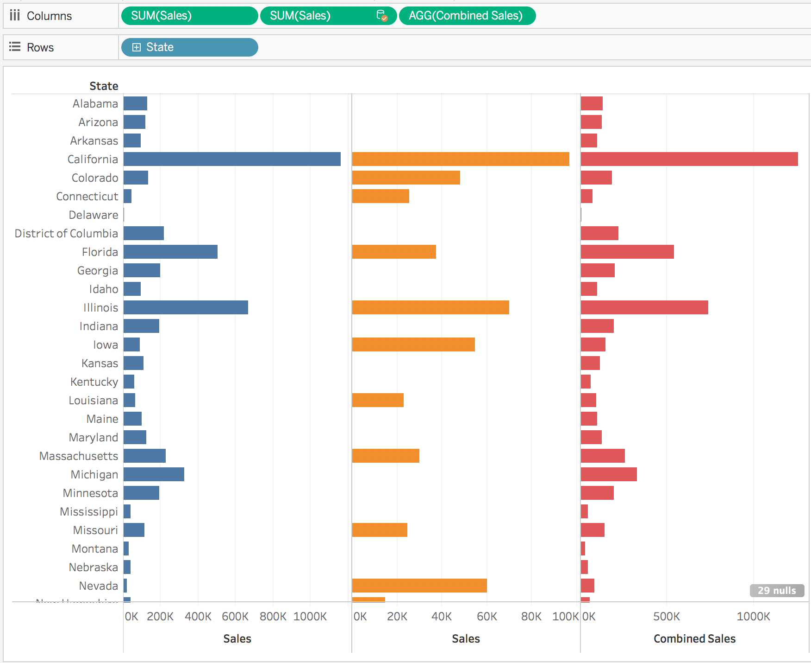
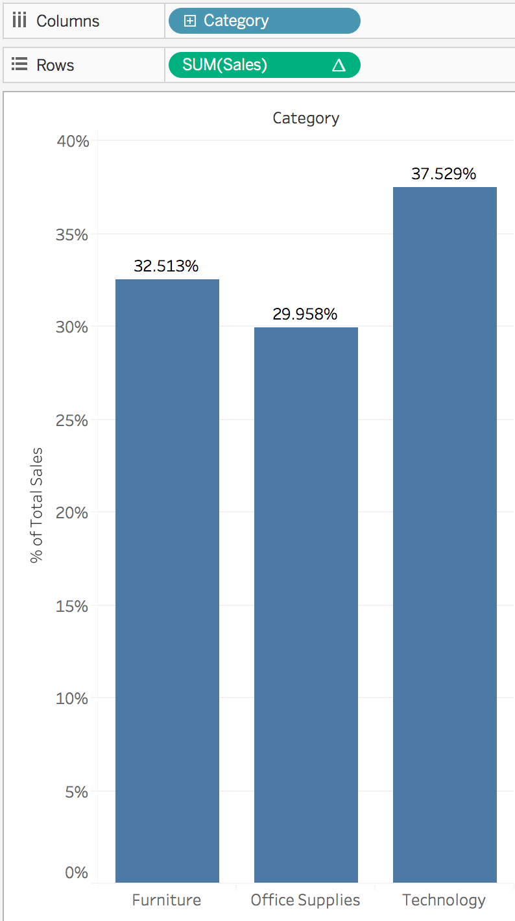
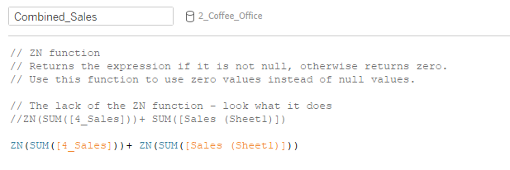
Tableau Class Activity
Import Excel data: office city.xlsx and coffee chain.xlsx
Create a calculated field:
For each state, calculate combined sales
Percent of Total

Slide 34
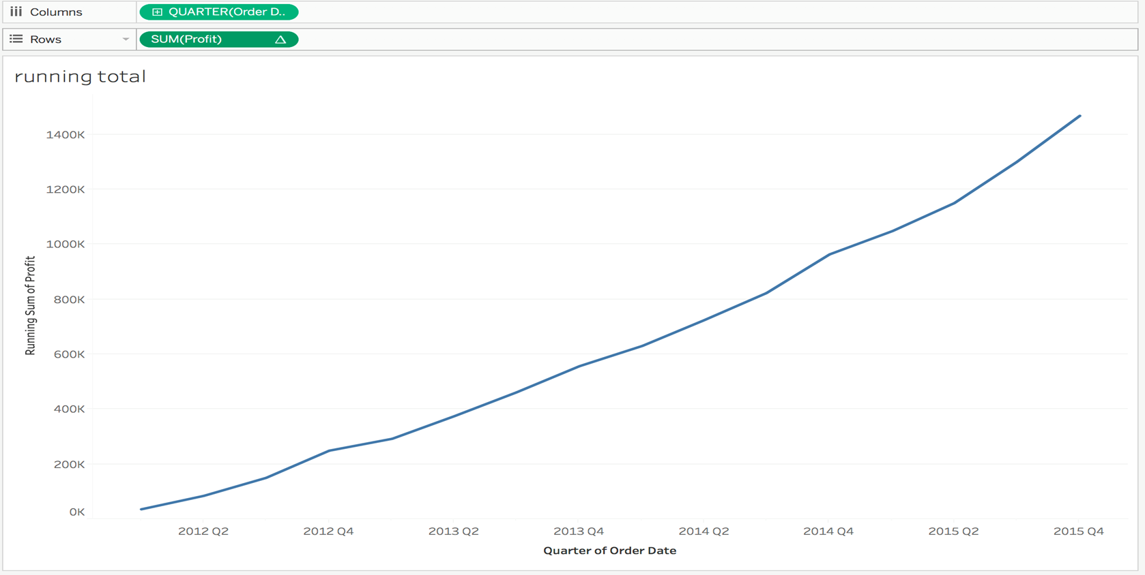
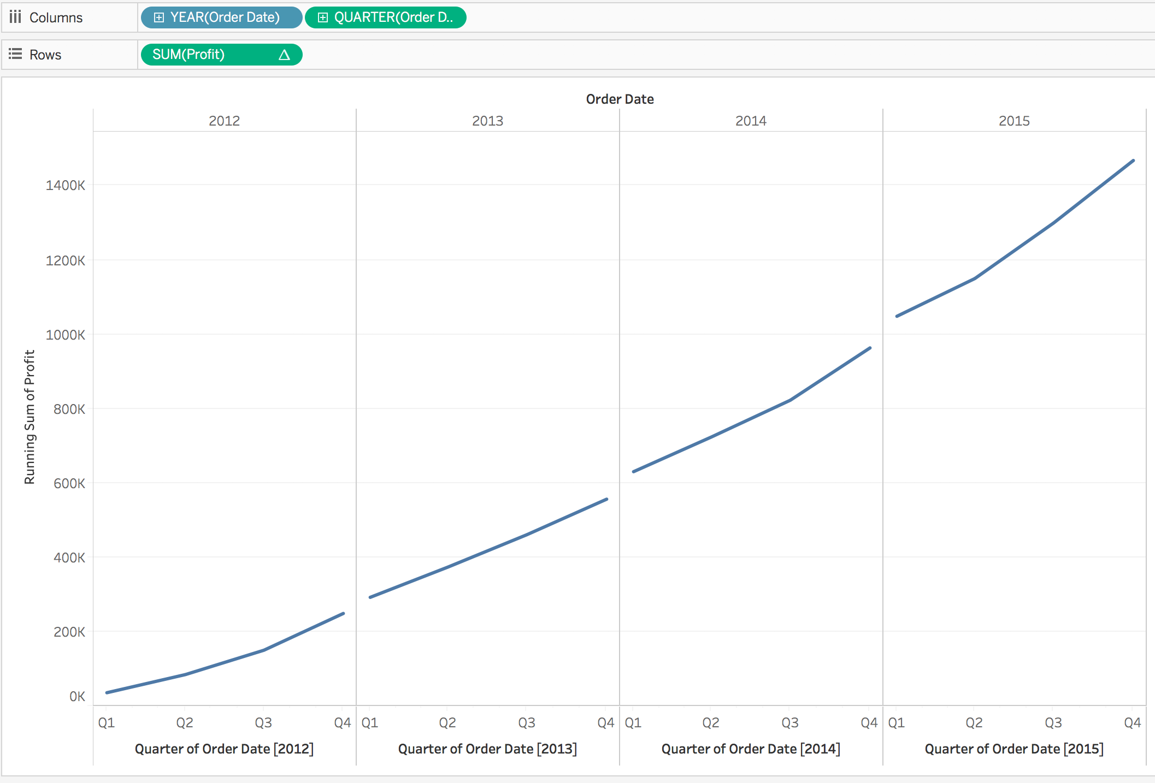
Tableau Class Activity
Using office city.xlsx and coffee chain.xlsx
Create a calculated field:
Running Total
Running total for each year (Is the chart correct?)

Slide 35
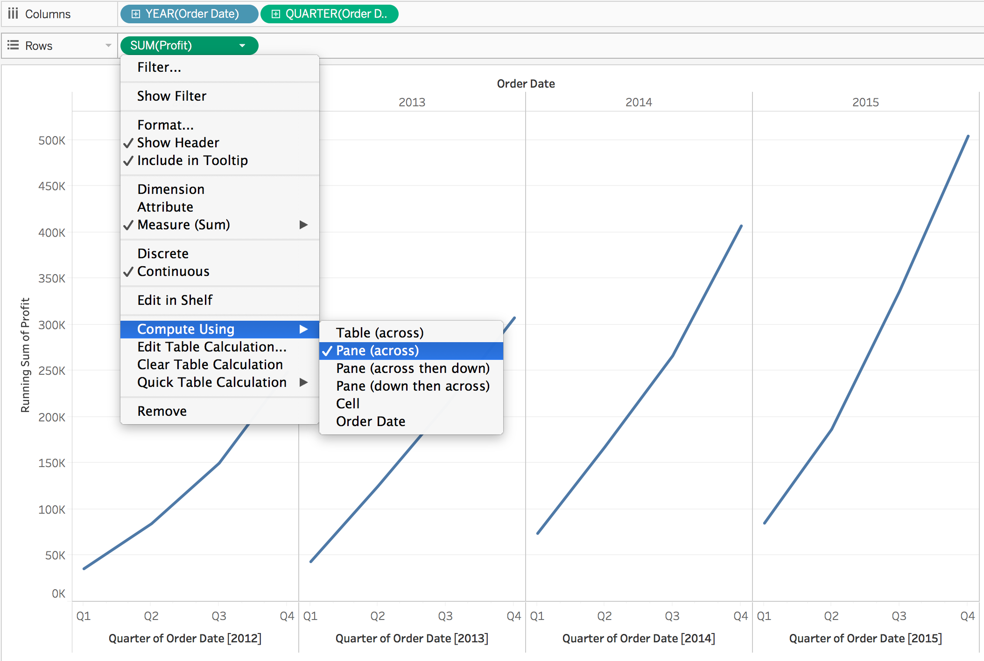
Tableau Class Activity
Using office city.xlsx and coffee chain.xlsx
Create a calculated field:
Running total for each year (done correctly)

Slide 36
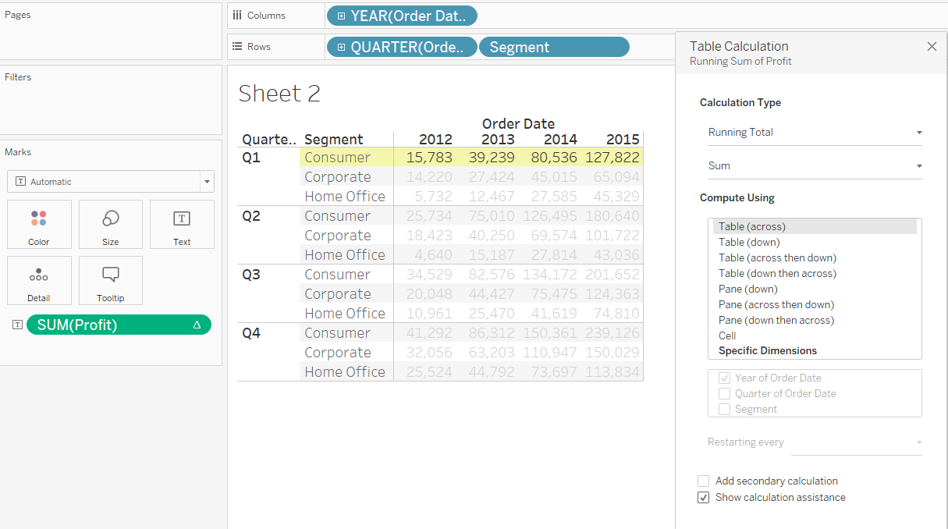
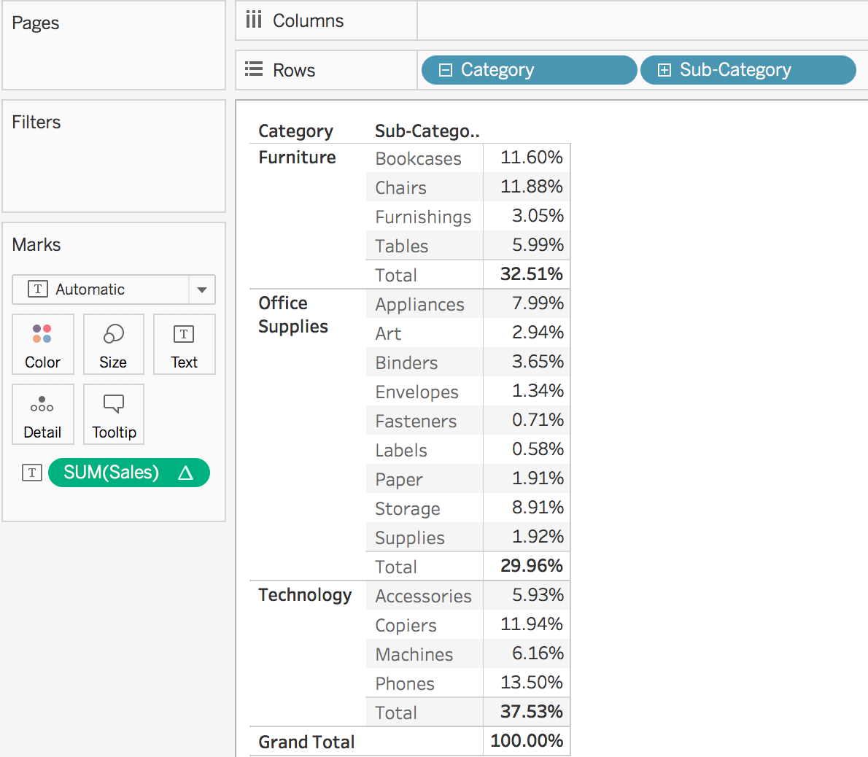
Tableau Class Activity
Using office city.xlsx and coffee chain.xlsx
Create some Quick Table Calculations:
Compare “Compute Using”

Slide 37
5 mins

Slide 38
Part 4 – Basic Data Visualisation

Slide 39
Visualisation of Categorical Data
Bar / Stacked Bar Chart
Side-by-side Bar Chart
Pie Chart
Area Chart
Heat Map
Tree Map

Slide 40
Visualisation of Categorical Data
Side-by-side (i.e., grouped) bar chart
Drag two or more measures into either the worksheet’s columns or rows.
Measure Values and Measure Names will then be created automatically.
Measure Names and Measure Values can be used to express various measures in a data set or multiple measures on a single axis.
Measure Values contains the data while Measure Names is used to separate the bars used on the marks

Slide 41
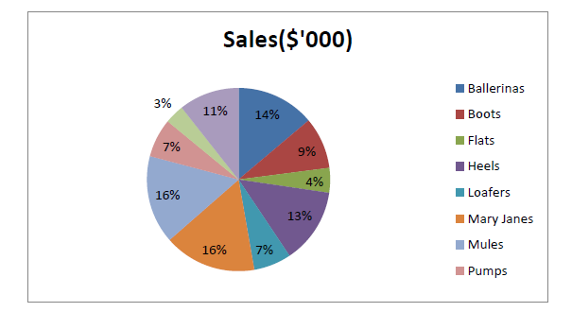
Visualisation of Categorical Data
Pie chart
Pie Chart should be used to get a general sense of magnitude, but not for precise comparisons.
A pie chart is limited by its area meaning that if you have many categories, you have many slivers and its hard to compare.

Slide 42
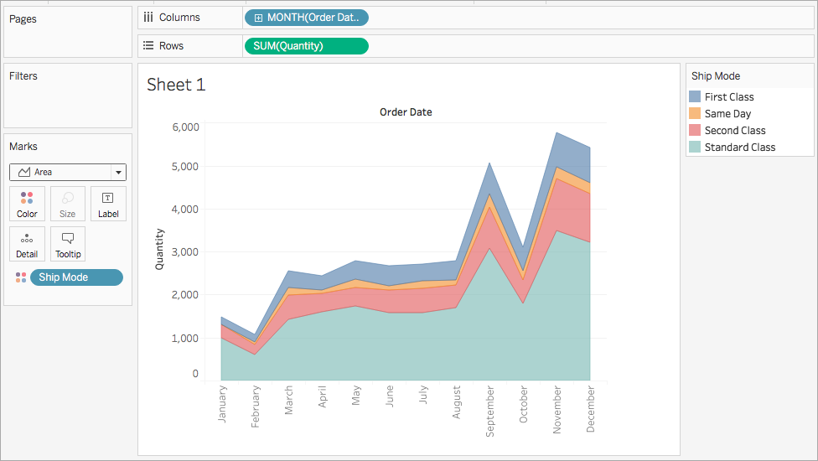
Visualisation of Categorical Data
Area chart
Area Fill chart plots values as bands, thus it is easy to misinterpret the top band as being the largest value in a data set.
The Area Fill Chart is best used to plot a single dimension to avoid such misinterpretation.

Slide 43
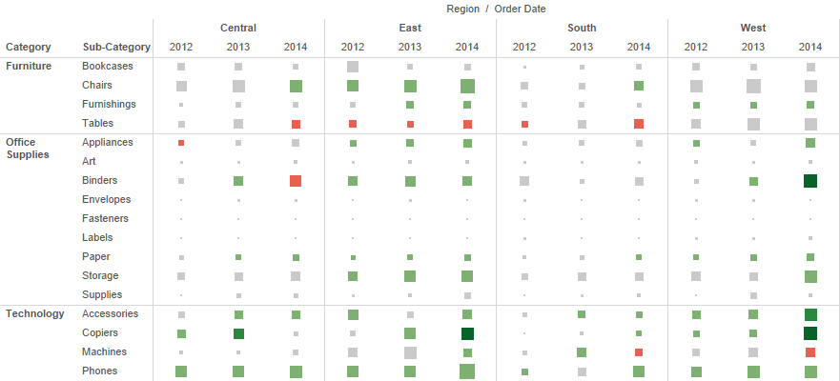
Visualisation of Categorical Data
Heat maps
Heat Maps use colours and sizes to compare up to two measures.

Slide 44
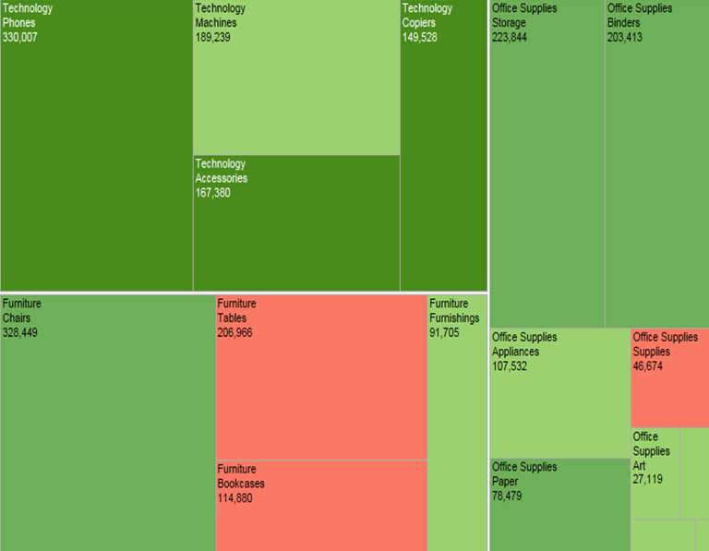
Visualisation of Categorical Data
Tree maps
Tree maps effectively display larger dimension sets using colours and sizes to display one or more dimensions, and up to two measures.

Slide 45
Visualisation of Time Series Data
Discrete (bucketed) time series data
Discrete time series data values are from specific points or blocks of time, and there is a finite number of possible values
A line chart is the most effective way to display time series data. A line chart for discrete time series data places breaks between time units like year, quarter, month and day
Bar, stacked bar charts, and scatterplots can also be used to display time series data
The power of “Time Series Analysis” lies in looking for trends in temporal data and forecasting i.e., based on what I see in the past, can I predict the future? Is this pattern seasonal/cyclical?
A whole picture view is more important than the individual data points

Slide 47
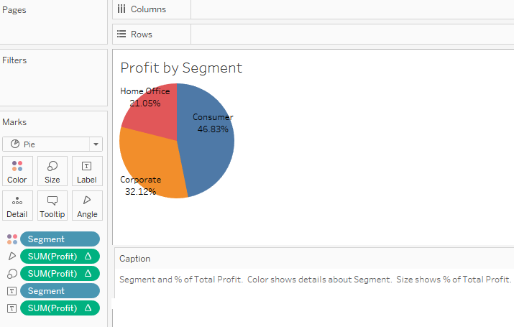
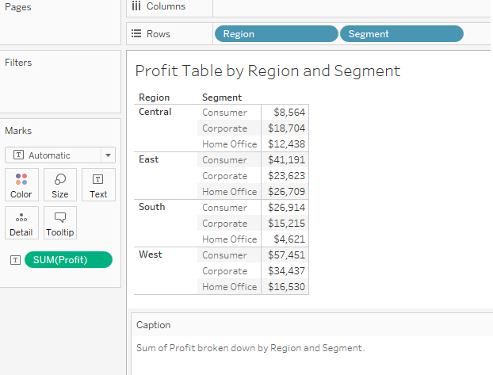
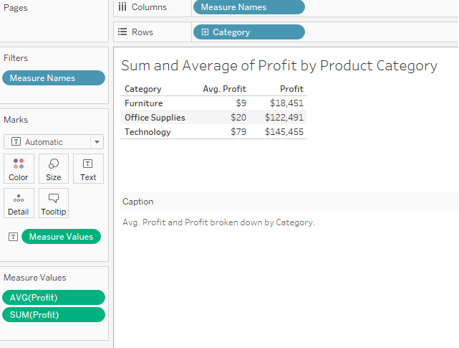
Tableau Class Activity
Using Excel data: global_superstore_2016.xlsx (orders)
Create the following
Simple report
Two measures report
Pie chart
Simple Report
Pie Chart
Two-Measures Report

Slide 48
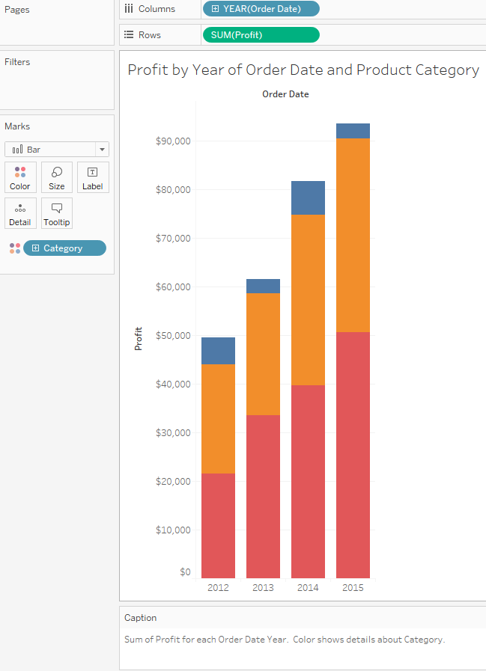
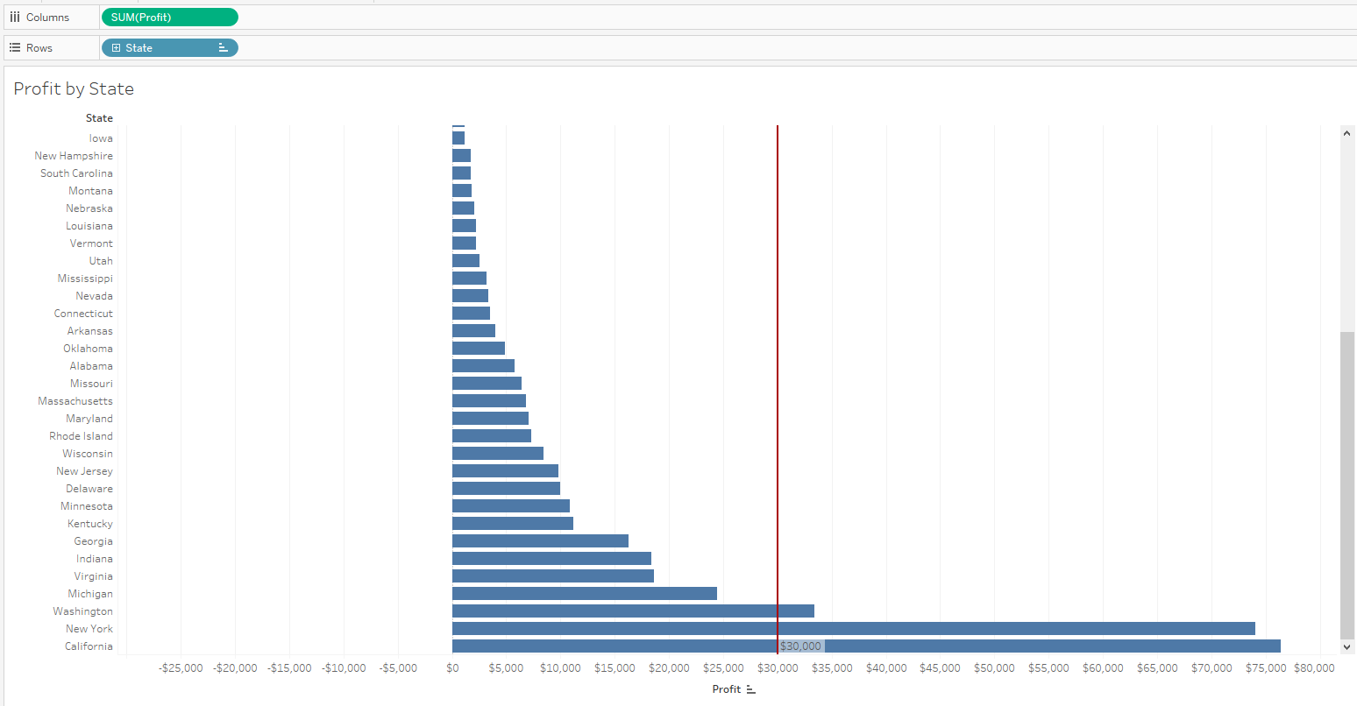
Tableau Class Activity
Using Excel data: global_superstore_2016.xlsx (orders)
Create the following
Bar chart with reference line
Stacked bar chart
Bar Chart with reference line
Stacked Bar Chart

Slide 49
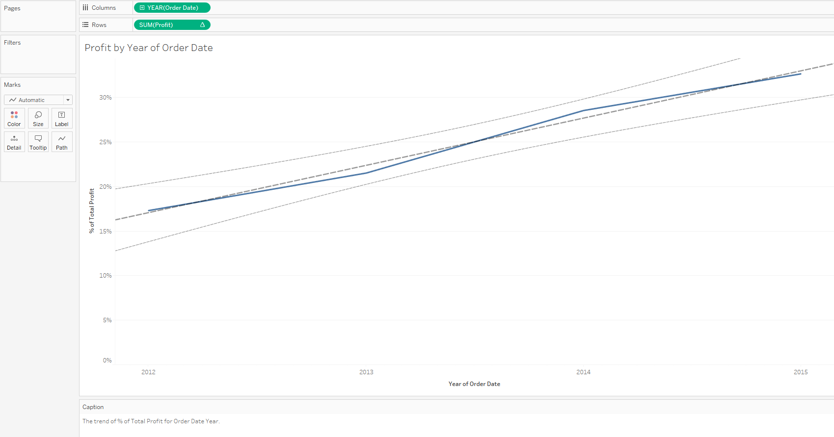
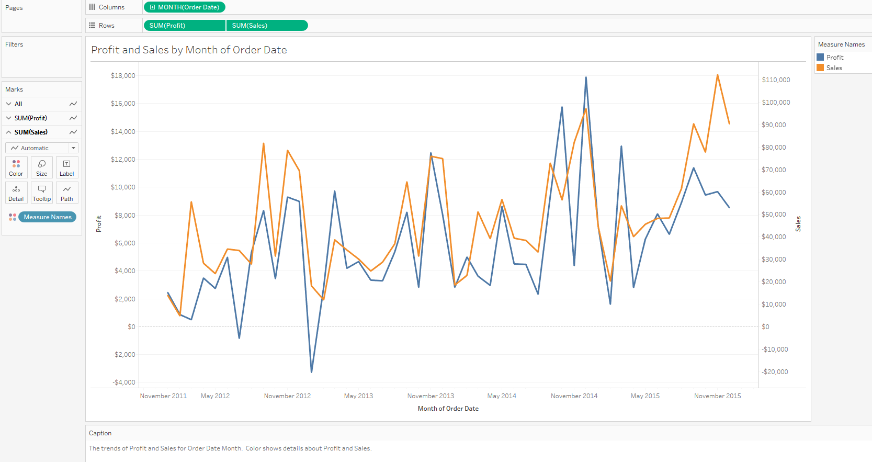
Tableau Class Activity
Using Excel data: global_superstore_2016.xlsx (orders)
Create the following
Line chart with trend line
Line chart with 2 axis
Line Chart with trend line
Line Chart with 2 Y-axis

Slide 50
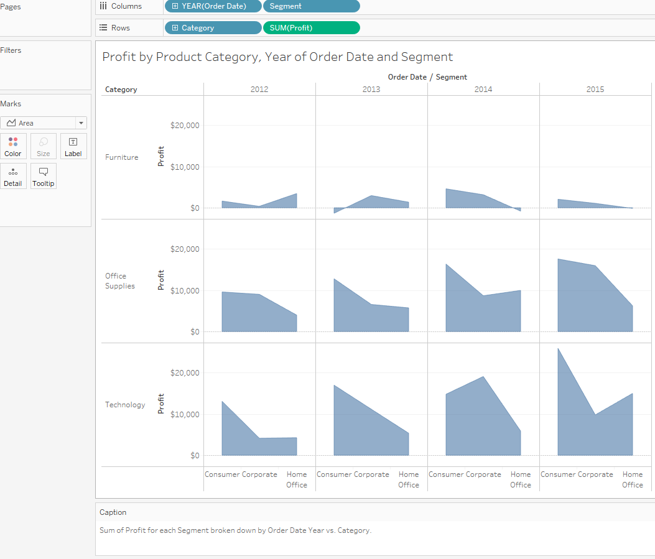
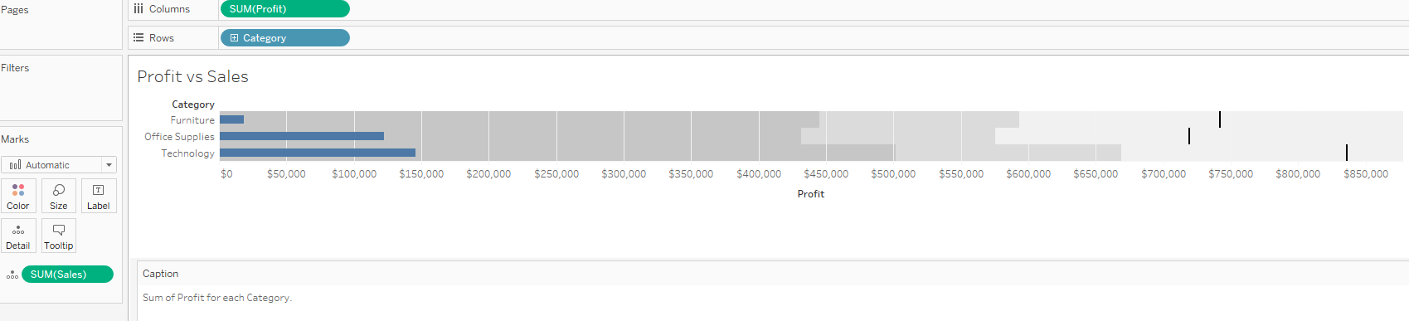
Tableau Class Activity
Area Chart
Using Excel data: global_superstore_2016.xlsx (orders)
Create the following
Area chart
Bullet chart
Bullet Chart

Slide 51
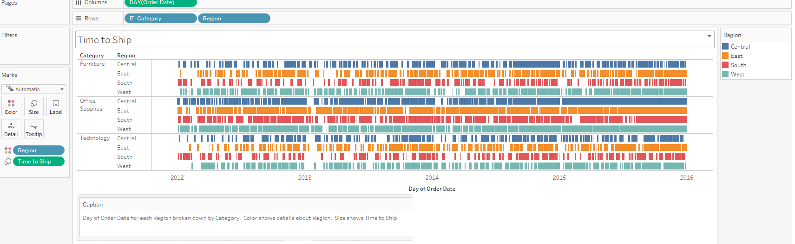
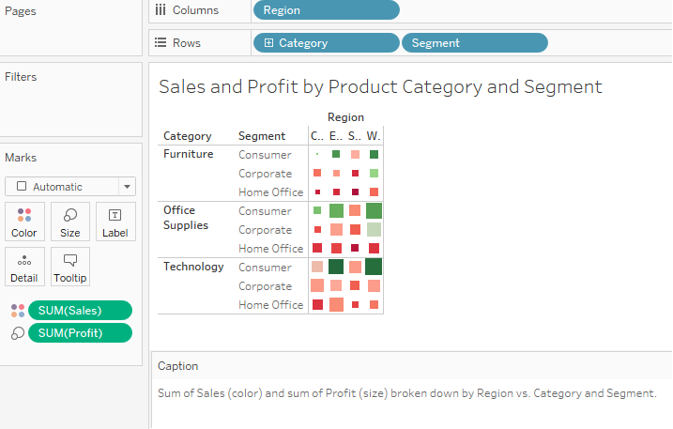
Tableau Class Activity
Gantt Chart
Using Excel data: global_superstore_2016.xlsx (orders)
Create the following
Gantt chart
Heat Map
Heat Map

Slide 52
Visualisation of Time Series Data
Continuous (unbroken) time series data
Visualising continuous time series data is similar to visualising discrete time series data. We still have a discrete number of data points, even if the dataset is continuous
Line chart for continuous time series data is presented as unbroken lines
Step charts are appropriate if the measure stays at a value for a long time and all of a sudden declines or inclines
Trendlines are useful in the presence of noisy data or large amounts of data

Slide 53
Visualisation of Time Series Data
Visualising time series data
Powerful Story Telling Tool – Crude Price & History
Line Chart
Sparkline Chart
Gantt Chart
Trendline
Reference Line

Slide 54
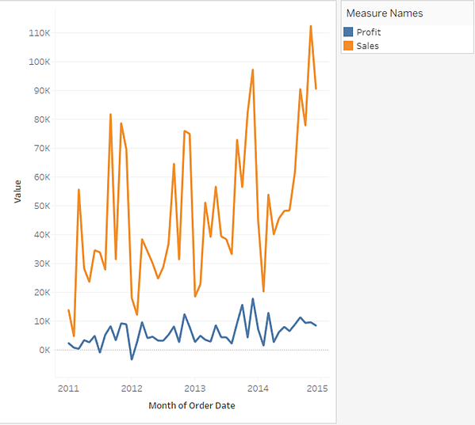
Visualisation of Time Series Data
Line Chart
Useful for data that does not stay constant i.e., is variable.
Data that stays constant, then suddenly changes, then stays constant etc is better visualized with a “step” graph
Data that is TOO highly variable (noisy data) sometimes needs to be smoothed and/or a “trend line” can be applied to make sense of it

Slide 55
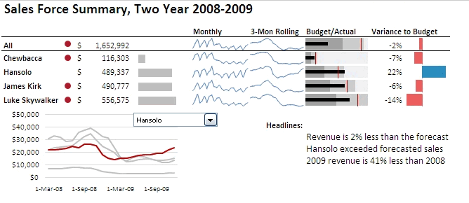
Visualisation of Time Series Data
Sparkline Chart
Information is displayed in a compact manner. However, this is a difficult plot style to grasp. Each element must be explained, and the audience needs to be guided

Slide 56
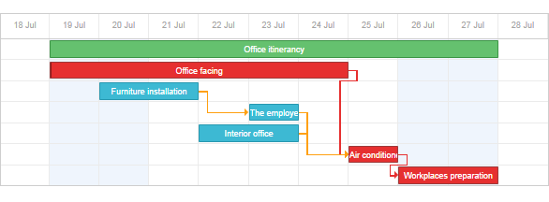
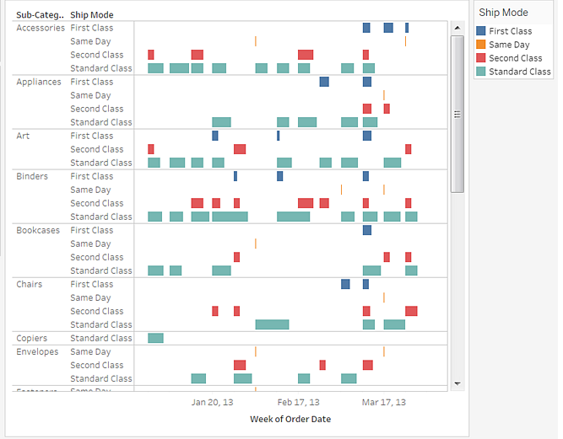
Visualisation of Time Series Data
Gantt Chart
Great project managing tool; has duration information and events/resources are visualized as bars. The physical position of the bars denotes start and end time; length is (obviously) duration.
Gantt charts also allow you to trace the “critical path”. Critical path analysis shows the sequence of scheduled tasks that determine the duration of a project. A critical path analysis identifies which tasks you must complete in order to meet your project deadline.

Slide 57
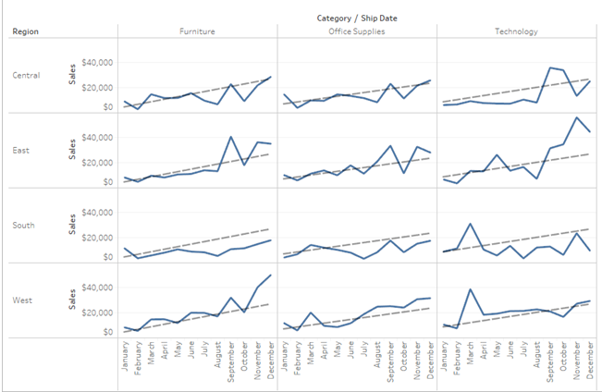
Visualisation of Time Series Data
Adding a trend line

Slide 58
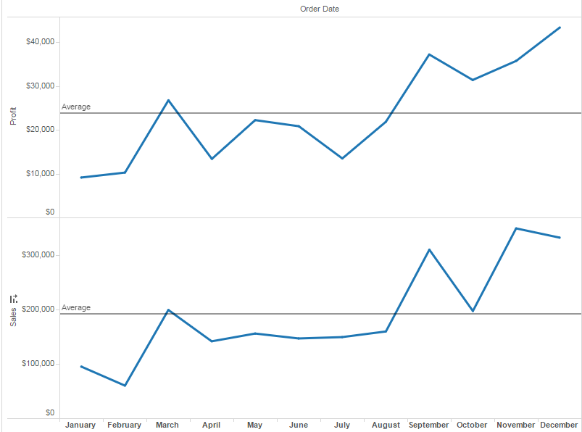
Visualisation of Time Series Data
Adding a reference line/band/distribution/boxes

Slide 60
15 mins

Slide 61
Part 5 – Advanced Data Visualisation

Slide 62
Visualisation of Spatial Data
Best practices for visualising spatial data
The most common way to visualise spatial data is with maps that place values within a geographic coordinate. We can visualise the geographic coordinate of a location by mapping the latitude and longitude coordinates to two-dimensional space, and draw a point on the space.
When the density of individual locations across a region is more informative than the overlapping points on a map, we may want to colour code the region based on the density scale, or use lines to show data continuously over geography.

Slide 63
Visualisation of Spatial Data
Best practices for visualising spatial data
We can also size the regions by the data and ignore the physical area, so that the regions with high density data will appear bigger than the regions with low density data
If we want to explore relationships between entities, we can plot each entity on a map, and draw lines to connect each with the others they are associated with
A practical tip - there is a “local” context component to spatial data mapping. For example, would you expect someone who has never been to Singapore to know where Clementi is on a map, unless its explicitly pointed out?
Maps require that you have some background knowledge of the locale; therefore, if you want to use maps, know your audience!

Slide 64
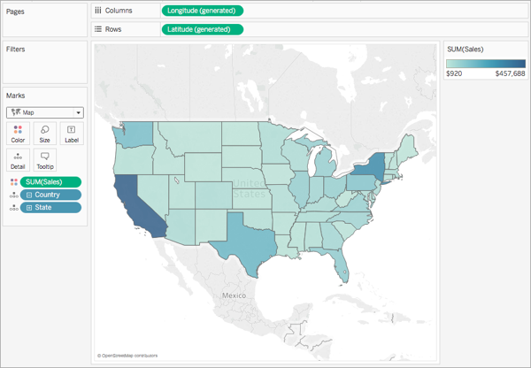
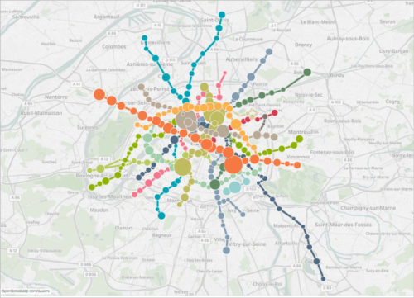
Visualisation of Spatial Data
Best practices for visualising spatial data
Map
Mapping Point-to-Point Details on Map

Slide 65
Visualisation of Spatial Data
Map
Assign “Geographic Role” to fields that are Geographic data.
Double click the “Region” field under Dimension of the Data window. The Tableau will automatically add Longitude and Latitude coordinates to the columns and rows shelves. The “Region” field is automatically placed on the Level of Detail shelf.
Drag the “Postal Code” field to the Level of Detail shelf to specify more details.

Slide 66
Visualisation of Spatial Data
Point-to-point details on map
Used to see linkages between data points e.g., point of origin of goods to where customers are based to answer questions related to “zone of influence”. Could be used to map transportation or logistic routes as well.
Note that it can be a bit overwhelming; sometimes in visualization, less is more!

Slide 67

Visualisation of Multi Variable Data
Best practices for visualising multi variable data
To visualise multi-variable data, we can fit all data onto a screen and display the relationships amongst variables or trends in each variables
We can use scatterplots to visualise the relationships amongst variables
However, if the relationships amongst variables are not so straightforward, we should consider using multiple views through more straightforward charts
Correlation → how one variable’s value tends to change in a certain way as the other variable’s value changes
Causation → Extent of how one variable will impact another
Easier to prove correlation than causation
Correlation DOES NOT IMPLY Causation

Slide 68
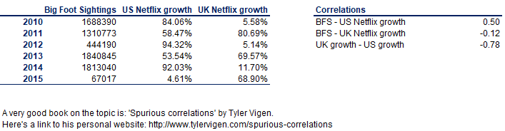
Visualisation of Multi Variable Data
Correlation vs Causation – An (absurd) example
Correlation is in the range of +/- 1, the larger the absolute number, the stronger the relationship between the 2 variables.
In the above example, I would say there is a (fairly) strong correlation between Big Foot Sightings and Netflix growth in the US. But would it be logical if I said big foot sightings cause the growth in US Netflix users?

Slide 69


Visualisation of Spatial Data
Visualising multi variable data
Circle View
Side-by-Side Circle Plots
Scatterplot

Slide 70

Visualisation of Spatial Data
Scatterplot
Uses Cartesian coordinates to display values for typically two variables for a set of data.
Dots not only report the values of individual data points, but also patterns when data are taken together i.e., how closely points are clustered together. Also useful to identify gaps in data.
Identification of correlational relationships are common with scatter plots. Variable on horizontal axis denoted an independent variable, and the variable on the vertical axis the dependent variable. Relationships between variables can be described in many ways: positive or negative, strong or weak, linear or nonlinear.
Overplotting
Can be difficult to tell how densely-packed data points are when many of them are in a small area.
Subset/Averaging
Optics - Adding transparency or reducing point size

Slide 71
Visualisation of Data Distributions
We can visualise the distribution of data at different granularities with bullet charts, bubble charts, and histograms
For single-variable distributions, using a histogram will enable us to see where the data is clustered and any outliers, by keeping track of where the outliers sit on the vertical axis
For multi-variable distributions, sometimes values come as pairs, so it makes more sense to visualise both values at the same time

Slide 72
Visualisation of Data Distributions
Bullet Chart
Bubble Chart
Histogram
Box Plot
Pareto Chart

Slide 73

Visualisation of Data Distributions
Bullet Chart
Reference line and reference distributions

Slide 74

Visualisation of Data Distributions
Bubble Chart
Use packed bubble charts to display data in a cluster of circles.
Dimensions define the individual bubbles, and measures define the size and color of the individual circles.
Note that its not very useful for precise comparisons

Slide 75


Visualisation of Data Distributions
Histogram
Histograms are used to show distributions of variables while bar charts are used to compare variables.
Histograms plot quantitative data with ranges of the data grouped into bins or intervals while bar charts plot categorical data.

Slide 76


Visualisation of Data Distributions
Box plot & Pareto Chart

Slide 77
Forecasting
Forecasting is the act of predicting future values based on historical values
Parameters are variables that allow data visualisation users to alter the content of a formula or change a dimension or measure contained in the view
Using parameters, data visualisation users can change normally static values into dynamic entities that facilitate ad-hoc analysis without the need to change the design of the data visualisation

Slide 78
Forecasting
Please read these two webpages to understand how to perform forecasting in Tableau…
https://help.tableau.com/current/pro/desktop/en-us/forecast_options.htm
https://help.tableau.com/current/pro/desktop/en-us/forecast_how_it_works.htm
Trend and season
Trend only
Season only
No trend or season
Parameters: Reference Line, Bin Size (Histogram), Ranking (in-value comparison)
Tableau recommends the best forecasting method for the data but note that “predicting” the future is always imprecise. Even simple trend lines have an implied “Ceteris Paribus” (all things being equal) assumption.
Don’t try to suggest/utilize forecasting data unless you are familiar with the methods, especially pros and cons.

Slide 80
10 mins

Slide 81
Part 6 – Dashboard & Storyboards

Slide 82


Dashboard Design Principles
Ask the fundamental questions:
Who (is my audience)?
What (is my objective – information sharing or KPI or …)?
Where (will I need to focus on – visuals, data, data collection)?
When (was this data collected, when do I intend for it to be actioned, is it still relevant)?
Why (is a dashboard necessary, can I just use pen and paper)?
How (will I explain what I created)?
Keep it simple
Don’t display everything
Keep to a single page
Avoid fancy formatting
Use layout and placement
Format numbers effectively
Use titles and labels effectively
Keep it Super Simple

Slide 83
Tableau Class Activity
Follow along to create a storyboard using dashboards for Amazing Mart.
Amazing Mart’s Sales Manager would like to have a dashboard that tracks the sales and profits of the products they sell.
The collected data is stored in 2 entities, List of Orders and Order Breakdown.
List of Orders contains information about the customer, such as customer name, the segment they are in, order date, shipping date, and mode.
Order Breakdown contains information about the product they purchased, the sales price and the profit that was made from the sales.

Slide 85


Tableau Class Activity

Slide 86
Thank you!

